Slide 1
Learning by Recording Cases

Slide 2
Learning
Learning by Recording Cases
Incremental Concept Learning
Classification
Version Spaces

Slide 3
Analogical Reasoning
Learning by Recording Cases
Case-Based Reasoning
Explanation-Based Learning
Analogical Reasoning

Slide 4
Lesson Preview
Learning by recording cases
Nearest neighbor method
Cases in the real world
k-Nearest Neighbor

Slide 5
Block World
Red
Orange
Blue
Black
Green
Purple

Slide 6
What color is this block?
Block World
Red
Orange
?
Blue
Black
Green
Purple

Slide 7
What color is this block?
Block World
Red
Orange
?
Blue
Black
Green
Black
Purple

Slide 8
Given new problem a
Retrieve most similar prior problem, b, from memory
Apply b’s solution to problem a
a
b
b
a

Slide 9
Block World
Red
Blue
Orange
Blue
Black
Green
Black
Green
Purple
Red
Orange
Purple

Slide 10
What color is this block?
Blue
?
?
Black
Green
Purple
Red
Orange

Slide 11
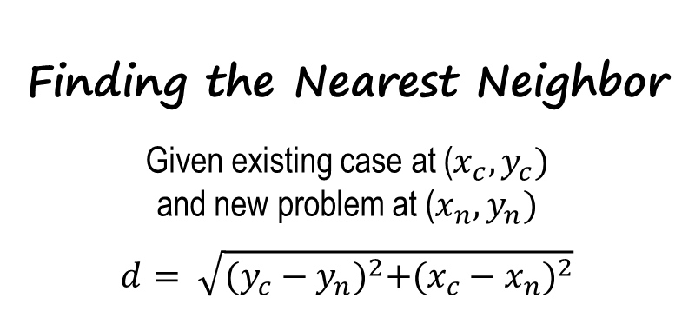
Blue
?
Black
Green
Purple
Red
Orange

Slide 12
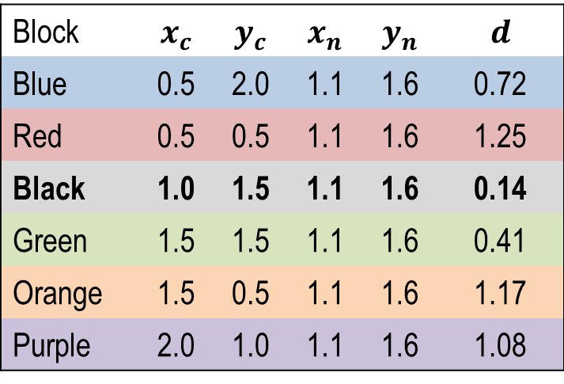
Blue
?
Black
Green
Purple
Red
Orange

Slide 13
What color is this block?
Blue
?
Black
Green
Width = 0.8
Height = 0.8
Purple
Red
Orange

Slide 14
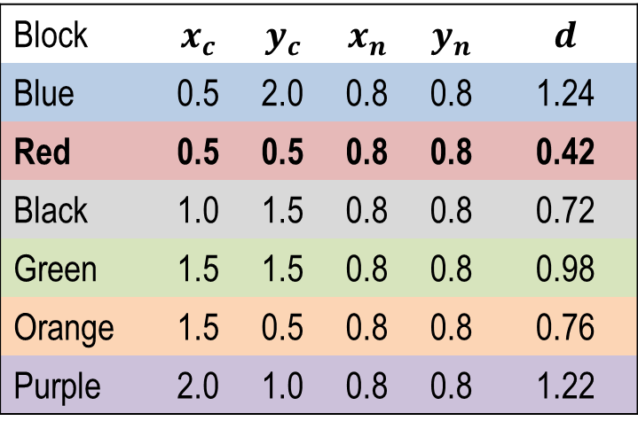
What color is this block?
Blue
?
Black
Green
?
Purple
Red
Orange

Slide 15
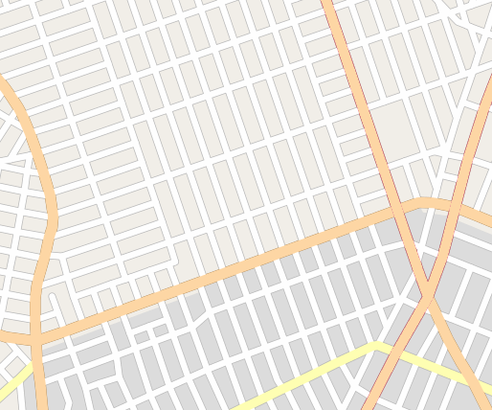
B
C
D
A
E
F

Slide 16
ο
ο
B
ο
C
D
Q
ο
What route is most similar to this new problem?
A
ο
E
ο
F

Slide 17
Routes by Origin
B
C
D
Q
B
A
C
D
Q
E
F
A
0 1 2 3 4 5 6 7 8 9 10
Routes by Destination
E
A
B
F
C
Q
E
D
F
0 1 2 3 4 5 6 7 8 9 10

Slide 18
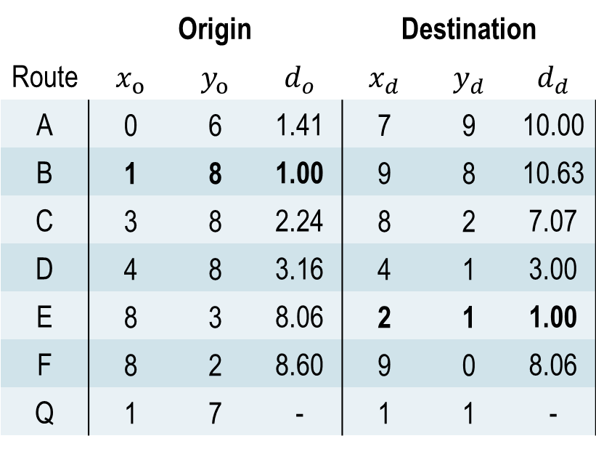
Routes by Origin
B
C
D
Q
A
E
F
Routes by Destination
A
B
C
Q
E
D
F

Slide 19
Routes by Origin
B
C
D
Q
A
E
F
Routes by Destination
A
B
C
Q
E
D
F

Slide 20
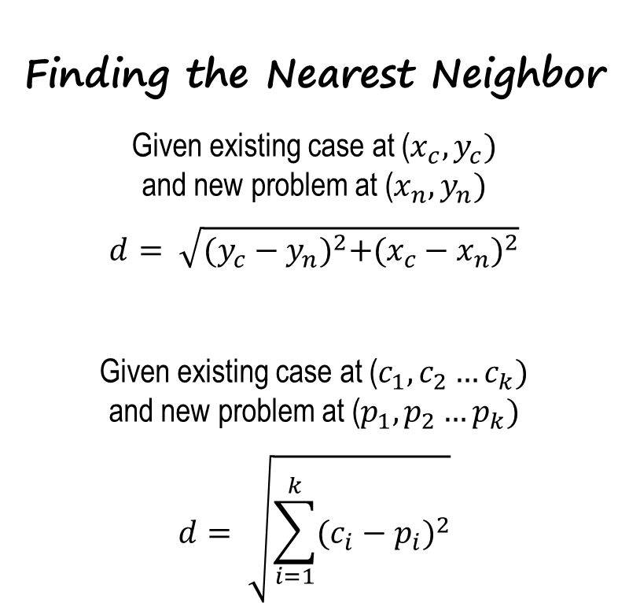
Routes by Origin
B
C
D
Q
A
E
F
Routes by Destination
A
B
C
Q
E
D
F

Slide 21
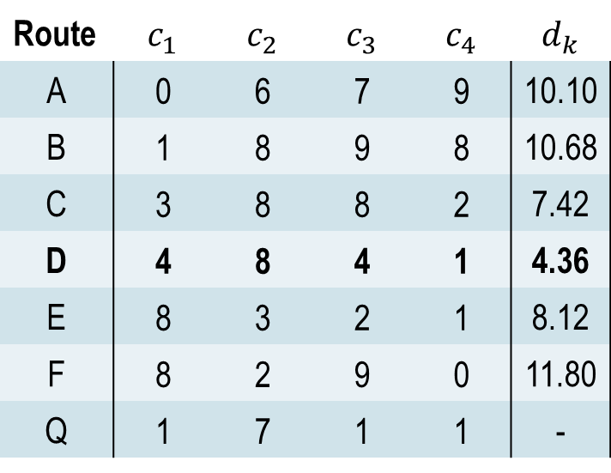
Routes by Origin
B
C
D
Q
A
E
F
Routes by Destination
A
B
C
Q
E
D
F

Slide 22
Assignment
How would you use recording cases to design an agent that could answer Raven’s Progressive Matrices?

Slide 23
To recap…
Recording and using cases
Nearest neighbor method
Cases in real-world problems
Nearest neighbor in k-dimensional problems

Slide 24
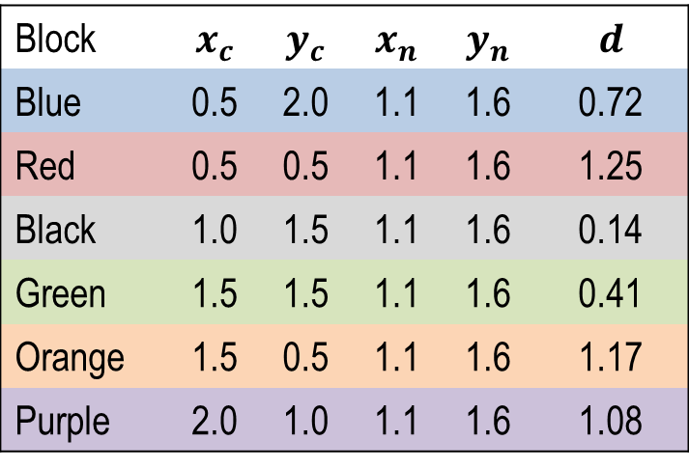
Finding the Nearest Neighbor
Given existing case at ($x_{c}, y_{c})$
and new problem at ($x_{n}, y_{n})$
$$d= \sqrt{{(y_{c}−y_{n})}^{2}+{(x_{c}−x_{n})}^{2}}$$
Block
Blue | 0.5 | 2.0 | 1.1 | 1.6 | 0.72
Red | 0.5 | 0.5 | 1.1 | 1.6 | 1.25
Black | 1.0 | 1.5 | 1.1 | 1.6 | 0.14
Green | 1.5 | 1.5 | 1.1 | 1.6 | 0.41
Orange | 1.5 | 0.5 | 1.1 | 1.6 | 1.17
Purple | 2.0 | 1.0 | 1.1 | 1.6 | 1.08
Block | $$x_{c}$$ | $$y_{c}$$ | $$x_{n}$$ | $$y_{n}$$ | $$d$$
Blue | 0.5 | 2.0 | 1.1 | 1.6 | 0.72
Red | 0.5 | 0.5 | 1.1 | 1.6 | 1.25
Black | 1.0 | 1.5 | 1.1 | 1.6 | 0.14
Green | 1.5 | 1.5 | 1.1 | 1.6 | 0.41
Orange | 1.5 | 0.5 | 1.1 | 1.6 | 1.17
Purple | 2.0 | 1.0 | 1.1 | 1.6 | 1.08
Block
Blue | 0.5 | 2.0 | 0.8 | 0.8 | 1.24
Red | 0.5 | 0.5 | 0.8 | 0.8 | 0.42
Black | 1.0 | 1.5 | 0.8 | 0.8 | 0.72
Green | 1.5 | 1.5 | 0.8 | 0.8 | 0.98
Orange | 1.5 | 0.5 | 0.8 | 0.8 | 0.76
Purple | 2.0 | 1.0 | 0.8 | 0.8 | 1.22

Slide 25
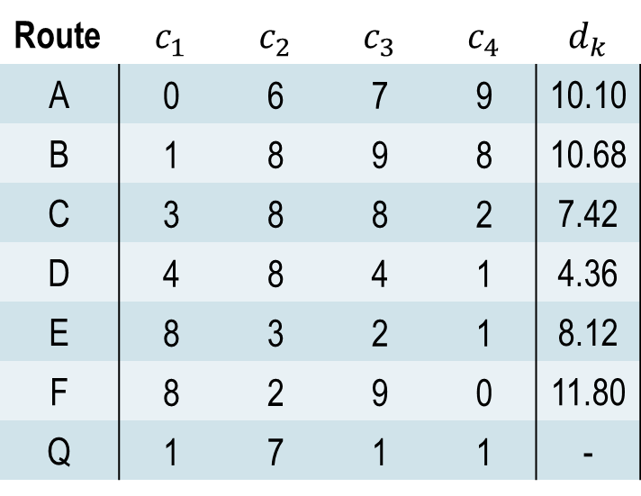
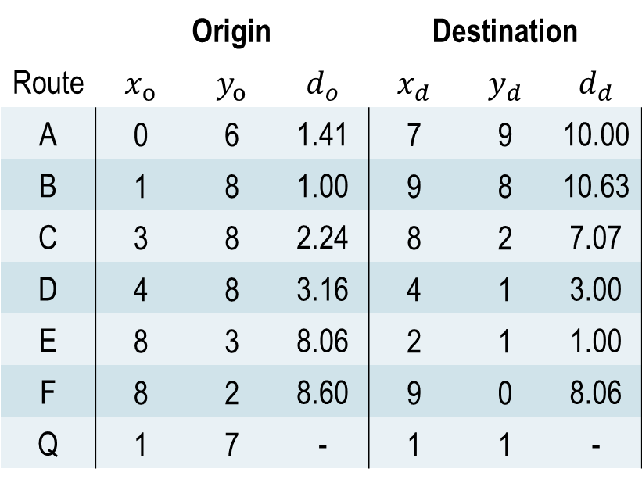
Route
A | 0 | 6 | 7 | 9 | 10.10
B | 1 | 8 | 9 | 8 | 10.68
C | 3 | 8 | 8 | 2 | 7.42
D | 4 | 8 | 4 | 1 | 4.36
E | 8 | 3 | 2 | 1 | 8.12
F | 8 | 2 | 9 | 0 | 11.80
Q | 1 | 7 | 1 | 1 | -
 | Origin |  |  | Destination
Route
A | 0 | 6 | 1.41 | 7 | 9 | 10.00
B | 1 | 8 | 1.00 | 9 | 8 | 10.63
C | 3 | 8 | 2.24 | 8 | 2 | 7.07
D | 4 | 8 | 3.16 | 4 | 1 | 3.00
E | 8 | 3 | 8.06 | 2 | 1 | 1.00
F | 8 | 2 | 8.60 | 9 | 0 | 8.06
Q | 1 | 7 | - | 1 | 1 | -

Slide 26
Finding the Nearest Neighbor
Given existing case at ($x_{c}, y_{c})$
and new problem at ($x_{n}, y_{n})$
$$d= \sqrt{{(y_{c}−y_{n})}^{2}+{(x_{c}−x_{n})}^{2}}$$
Given existing case at ($c_{1}, c_{2}…c_{k})$
and new problem at ($p_{1}, p_{2}…p_{k})$
$$d= \sqrt{\sum_{i=1}^{k}{{(c_{i}−p_{i})}^{2}}}$$
 | Origin |  |  | Destination
Route
A | 0 | 6 | 1.41 | 7 | 9 | 10.00
B | 1 | 8 | 1.00 | 9 | 8 | 10.63
C | 3 | 8 | 2.24 | 8 | 2 | 7.07
D | 4 | 8 | 3.16 | 4 | 1 | 3.00
E | 8 | 3 | 8.06 | 2 | 1 | 1.00
F | 8 | 2 | 8.60 | 9 | 0 | 8.06
Q | 1 | 7 | - | 1 | 1 | -

